Slide 1


Evaluating the Efficacy of Artificial Neural Networks in Classifying Isotopic Signatures: Applications for Forensic Provenancing
Thomas A. Delgado, M.A.¹
Eric J. Bartelink, Ph.D.¹
R. Carter Tillquist, Ph.D.²
¹California State University, Chico – Anthropology
²California State University, Chico – Computer Science

Slide 2
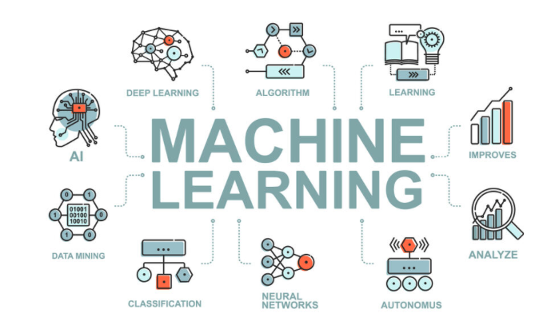

Introduction
Thinking back on 2023…
Looking at 2024:
AI symposia, workshops, and special issues
Thinking about the future:
Anthropologists will continue to generate novel data – and a lot of it
Needs to analyze this data will necessitate more robust analytical methods
AI and machine learning are useful tools for automating data analysis and teasing apart nuanced data patterns
Notes:
At last year’s AABA there was a rich conversation around machine learning and artificial intelligence in anthropological research. This demonstrated that there are myriad perceptions regarding the utility and function of these resources when analyzing data; however, this has not prevented further research using these resources. Conference symposia and workshops have been developed that are centered on AI and machine learning. Several posters and presentations here and at the American Academy of Forensic Sciences utilized AI as their analytical method. Anthropology News is centering its third-issue of this year on artificial intelligence. These developments highlight that the future is rooted in these technologies and that anthropologists will, at some point, necessitate the use of these tools. We have been living in an era of “big data” and as our data grows, means to robustly analyze it will have to be developed. This raises the question: what exactly is AI?

Slide 3




Artificial Intelligence and Machine Learning
Any technique that enables a machine to mimic human cognition
Artificial Intelligence
Digital Voice Assistants
Ad-Tracking and Curated Search Results
Chatbots and Large Language Models
Social Media Algorithmization
Notes:
Artificial intelligence represents the broad concept in computer science for any technique that enables a machine to mimic human thought. AI is not limited solely to the analysis of large quantities of data, but instead centers on a machine’s ability to complete complex, human-like, tasks. This can take the form of a digital voice assistant that sets your alarms, to social media algorithms that dictate what you see, to the tracking of internet usage to provide curated ads and search results. Importantly, AI is premised on the successful completion of a task.

Slide 4
Artificial Intelligence and Machine Learning
Artificial Intelligence
Any technique that enables a machine to mimic human cognition
Machine Learning
Automatic detection of patterns in data
Prediction of outcomes based on prior knowledge
Data Input
Statistics
Prediction Output
Feedback
Notes:
Machine learning, on the other hand, focuses on how a machine can be taught to complete the task. As a subset of AI, machine learning relies on the detection of patterns in a dataset to “teach” a computer to predict outcomes based on prior knowledge. This is done through a training process where data is input to a machine learning algorithm which performs some statistical analyses before generating predictions based on patterns detected in the dataset. The machine learning model then receives some form of feedback, such as when a prediction was correct or incorrect, before re-analyzing the data and repeating. This allows for models to be optimized on certain types of data, increasing overall prediction accuracies and model performance.

Slide 5
Artificial Intelligence and Machine Learning
Artificial Intelligence
Any technique that enables a machine to mimic human cognition
Machine Learning
Automatic detection of patterns in data
Prediction of outcomes based on prior knowledge
Utilizes Artificial Neural Networks (ANNs)
Self organizes in response to data
DOES NOT RELY ON USER MEDIATED FEATURE EXTRACTION
Deep Learning
Notes:
And taking it just a step further, deep learning is a subset of machine learning that focuses on the utility of artificial neural networks, which is the primary application here. Neural networks are unique as they automate the process of feedback allowing them to self-organize in response to data. This self-organization process also allows them to work on data that are unstructured with very little human intervention needed. When using deep learning, data go through multiple different layers that each contain multiple different algorithms. This is opposed to broader machine learning that generally applies one specific algorithm to the entire dataset. This allows deep learning to make predictions with a greater degree of accuracy than other types of machine learning.

Slide 6
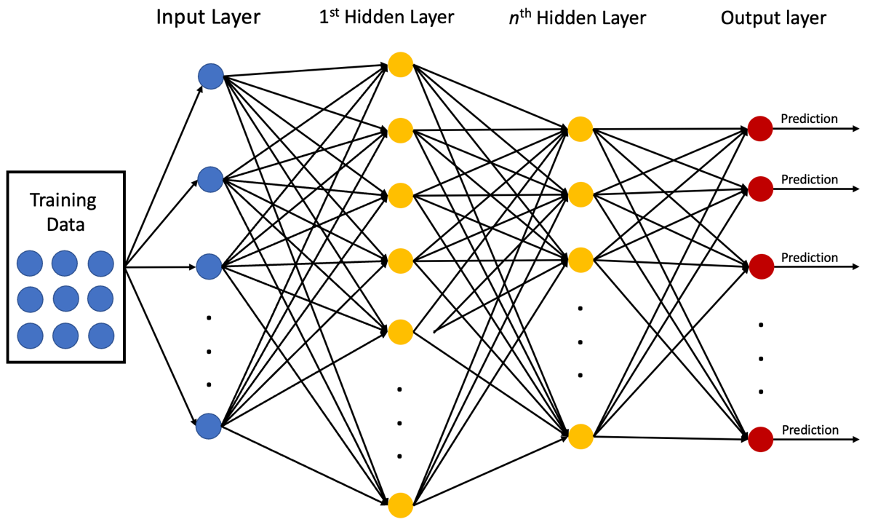
Artificial Neural Networks (ANNs)
Notes:
So here’s an image of an artificial neural network – or ANN, but how does it work?

Slide 7
Artificial Neural Networks (ANNs)
How does it work?
Activation functions, system of weights
Pros: Works well with complex data, self-organizing, generalizable
Cons: High computing cost, difficult to tune, difficult to interpret
Notes:
ANNs attempt to replicate the processes of biological neurons by feeding data through a system of weights then requiring each value to reach a certain threshold before passing it onto the next system of weights and so on and so on until it ultimately generates a prediction. Like anything there are positives and negatives (click). ANNs tend to work well with complex and nuanced data and are capable self-adjusting their weights to better generalize the model; however, they require a lot of computing power, more than many other machine learning methods. They also have many parameters to adjust making them difficult to tune and, just like we don’t know exactly how we think, it is difficult to interpret the reasonings behind the predictions made from this algorithm. Depending on the application, an ANN is not always appropriate

Slide 8
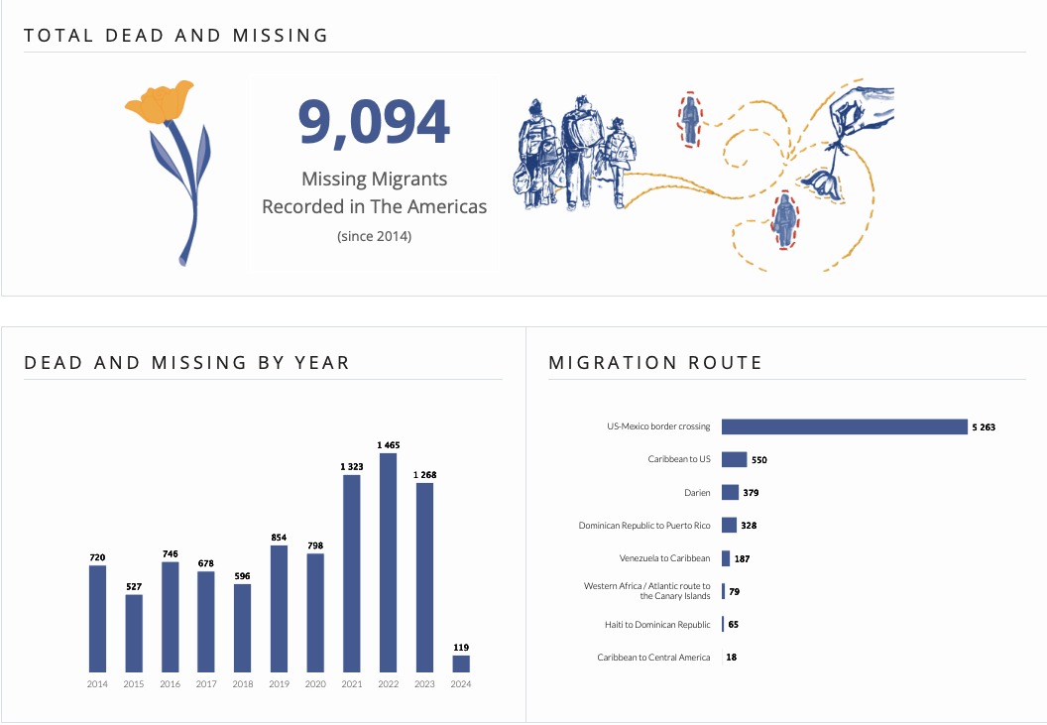


Migrant Death at the U.S. – Mexico Border
Notes:
One application that could benefit from the utility of ANNs and AI in general is the effort to identify remains found at the US-Mexico border, specifically in the estimation of region-of-origin based on the stable isotope ratios engrained in those remains. Our southern border has become one of the world’s deadliest diasporic places with over 9,000 people reported dead or missing in the last ten years, and this is almost certainly an under-estimation. Violence on oppressed people around the globe will continue to generate remains devoid of identity and methods to return this identity should continue to be developed.

Slide 9
IsoPredict: Forensic Provenancing
Geospatial patterning of elements (isotopes):
Different parts of the world exhibit different elemental patterning
Isotopic Classification:
Infer region-of-origin from elemental composition of human tissues (O, H, Sr, Pb, S) correlated to their lived environment
Resolution:
Level of specificity able to predicted (e.g., region-level, country-level, state-level, etc.)
Other Programs:
AssignR (Ma et al. 2020); Odds-Ratio / Bayesian Inversion
The QR Code apparently got deactivated. Link is:
https://github.com/Tadelgado42/IsoPredict
Notes:
In this vein, we developed the “IsoPredict” program to aid in classifying isotope values into regions throughout Mesoamerica. All the code and data for this program can be accessed using this QR code. Isotopic classification is premised on the geospatial patterning of elements that correlate to a person’s lived environment. Using this patterning, the elemental composition within human tissues provide a means to estimate where people have migrated and traveled. A major barrier to this analysis is the level of specificity that region-of-origin can be predicted due to isotopic similarity over large landmasses. It is in increasing this resolution that AI could prove most helpful.

Slide 10
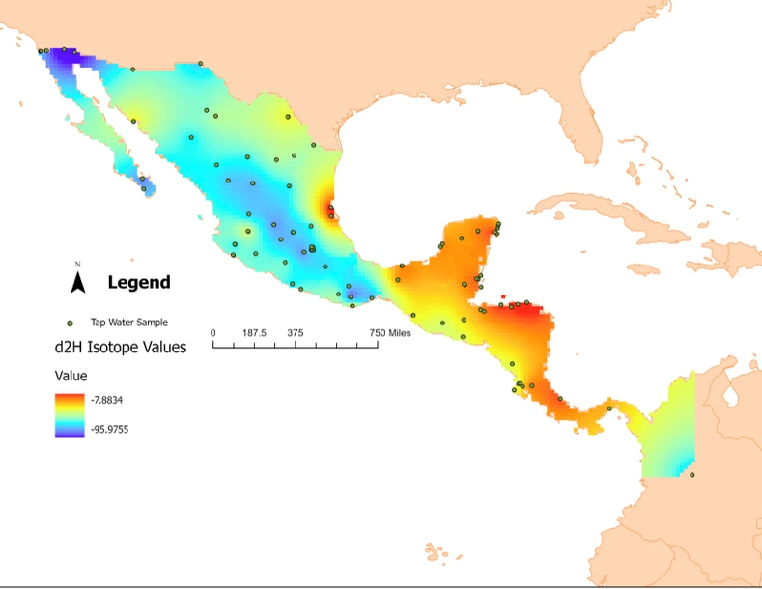
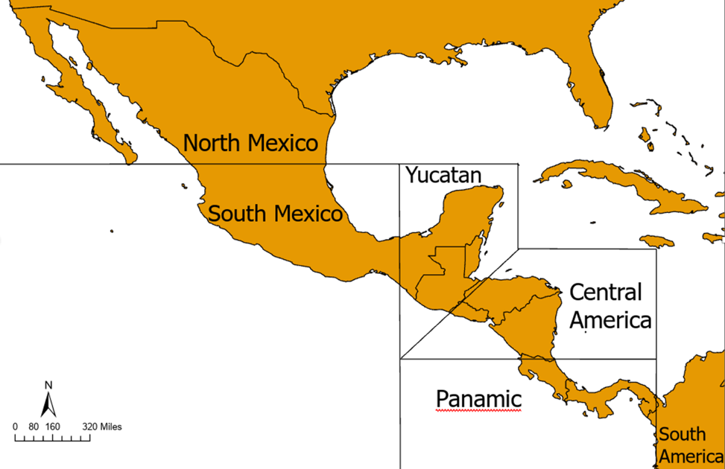
Isotope Data Collection and Interpolation
Research Design
Water Isotope Dataset (waterisotopes.org)
δ²Η and δ¹⁸Ο from tap and bottled water sources (n=171)
Empirical Bayesian Kriging Dataset
Interpolates missing values (N=3,746; random sample n=720)
Standard error: δ¹⁸Ο=1.71‰; δ²Η=10.35‰
Isoscape
Sub-regions
Notes:
Water isotope data spanning from Mexico to Colombia was extracted from the University of Utah’s water isotope database focusing on the most likely to be consumed water sources, tap water and bottled water. From these initial data, an empirical Bayesian kriging isoscape was developed to infer values consistently through the entire region. Six sub-regions were then created based on geographical landmarks, such as tropics, for isotope values to be classified into.

Slide 11
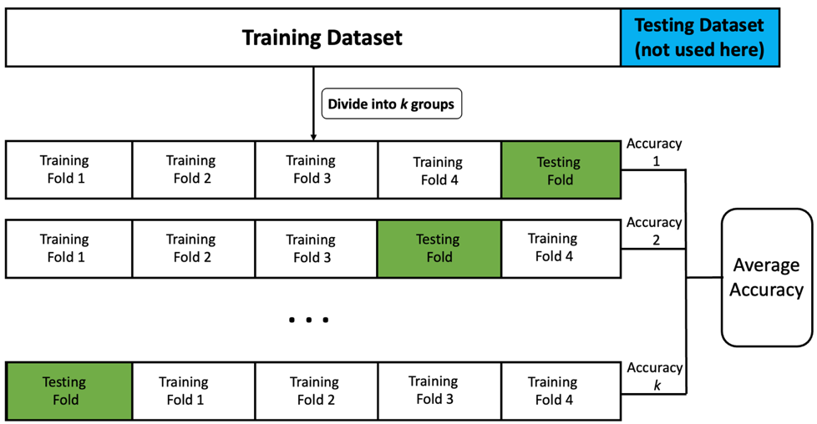
Training and Evaluation
Research Design
Training Split: 80% Training Data; 20% Testing Data
Evaluation Methods: K-Fold Cross Validation (k=5), f1 scores (precision and recall)
Testing Dataset
Notes:
This dataset was then split into training and testing datasets with 80% of the data being used to train and 20% held for testing. Accuracy was evaluated using k-folds cross validation with five folds which resamples the training data into five smaller sets and applies the classifier to each subset before averaging each accuracy – seen here. Models were also evaluated based on their f1 score which represents the harmonic mean of both the model’s precision and recall which are considered better performance metrics than accuracy alone

Slide 12

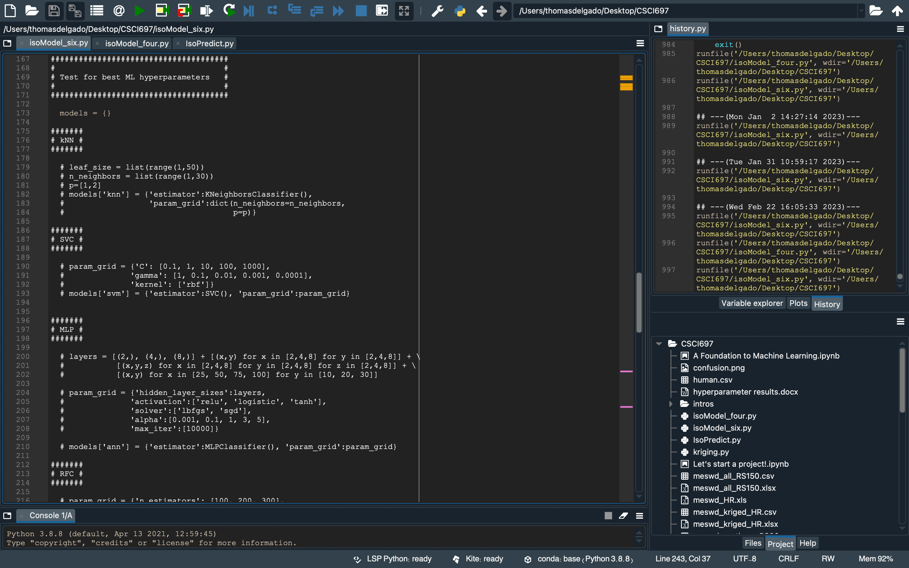
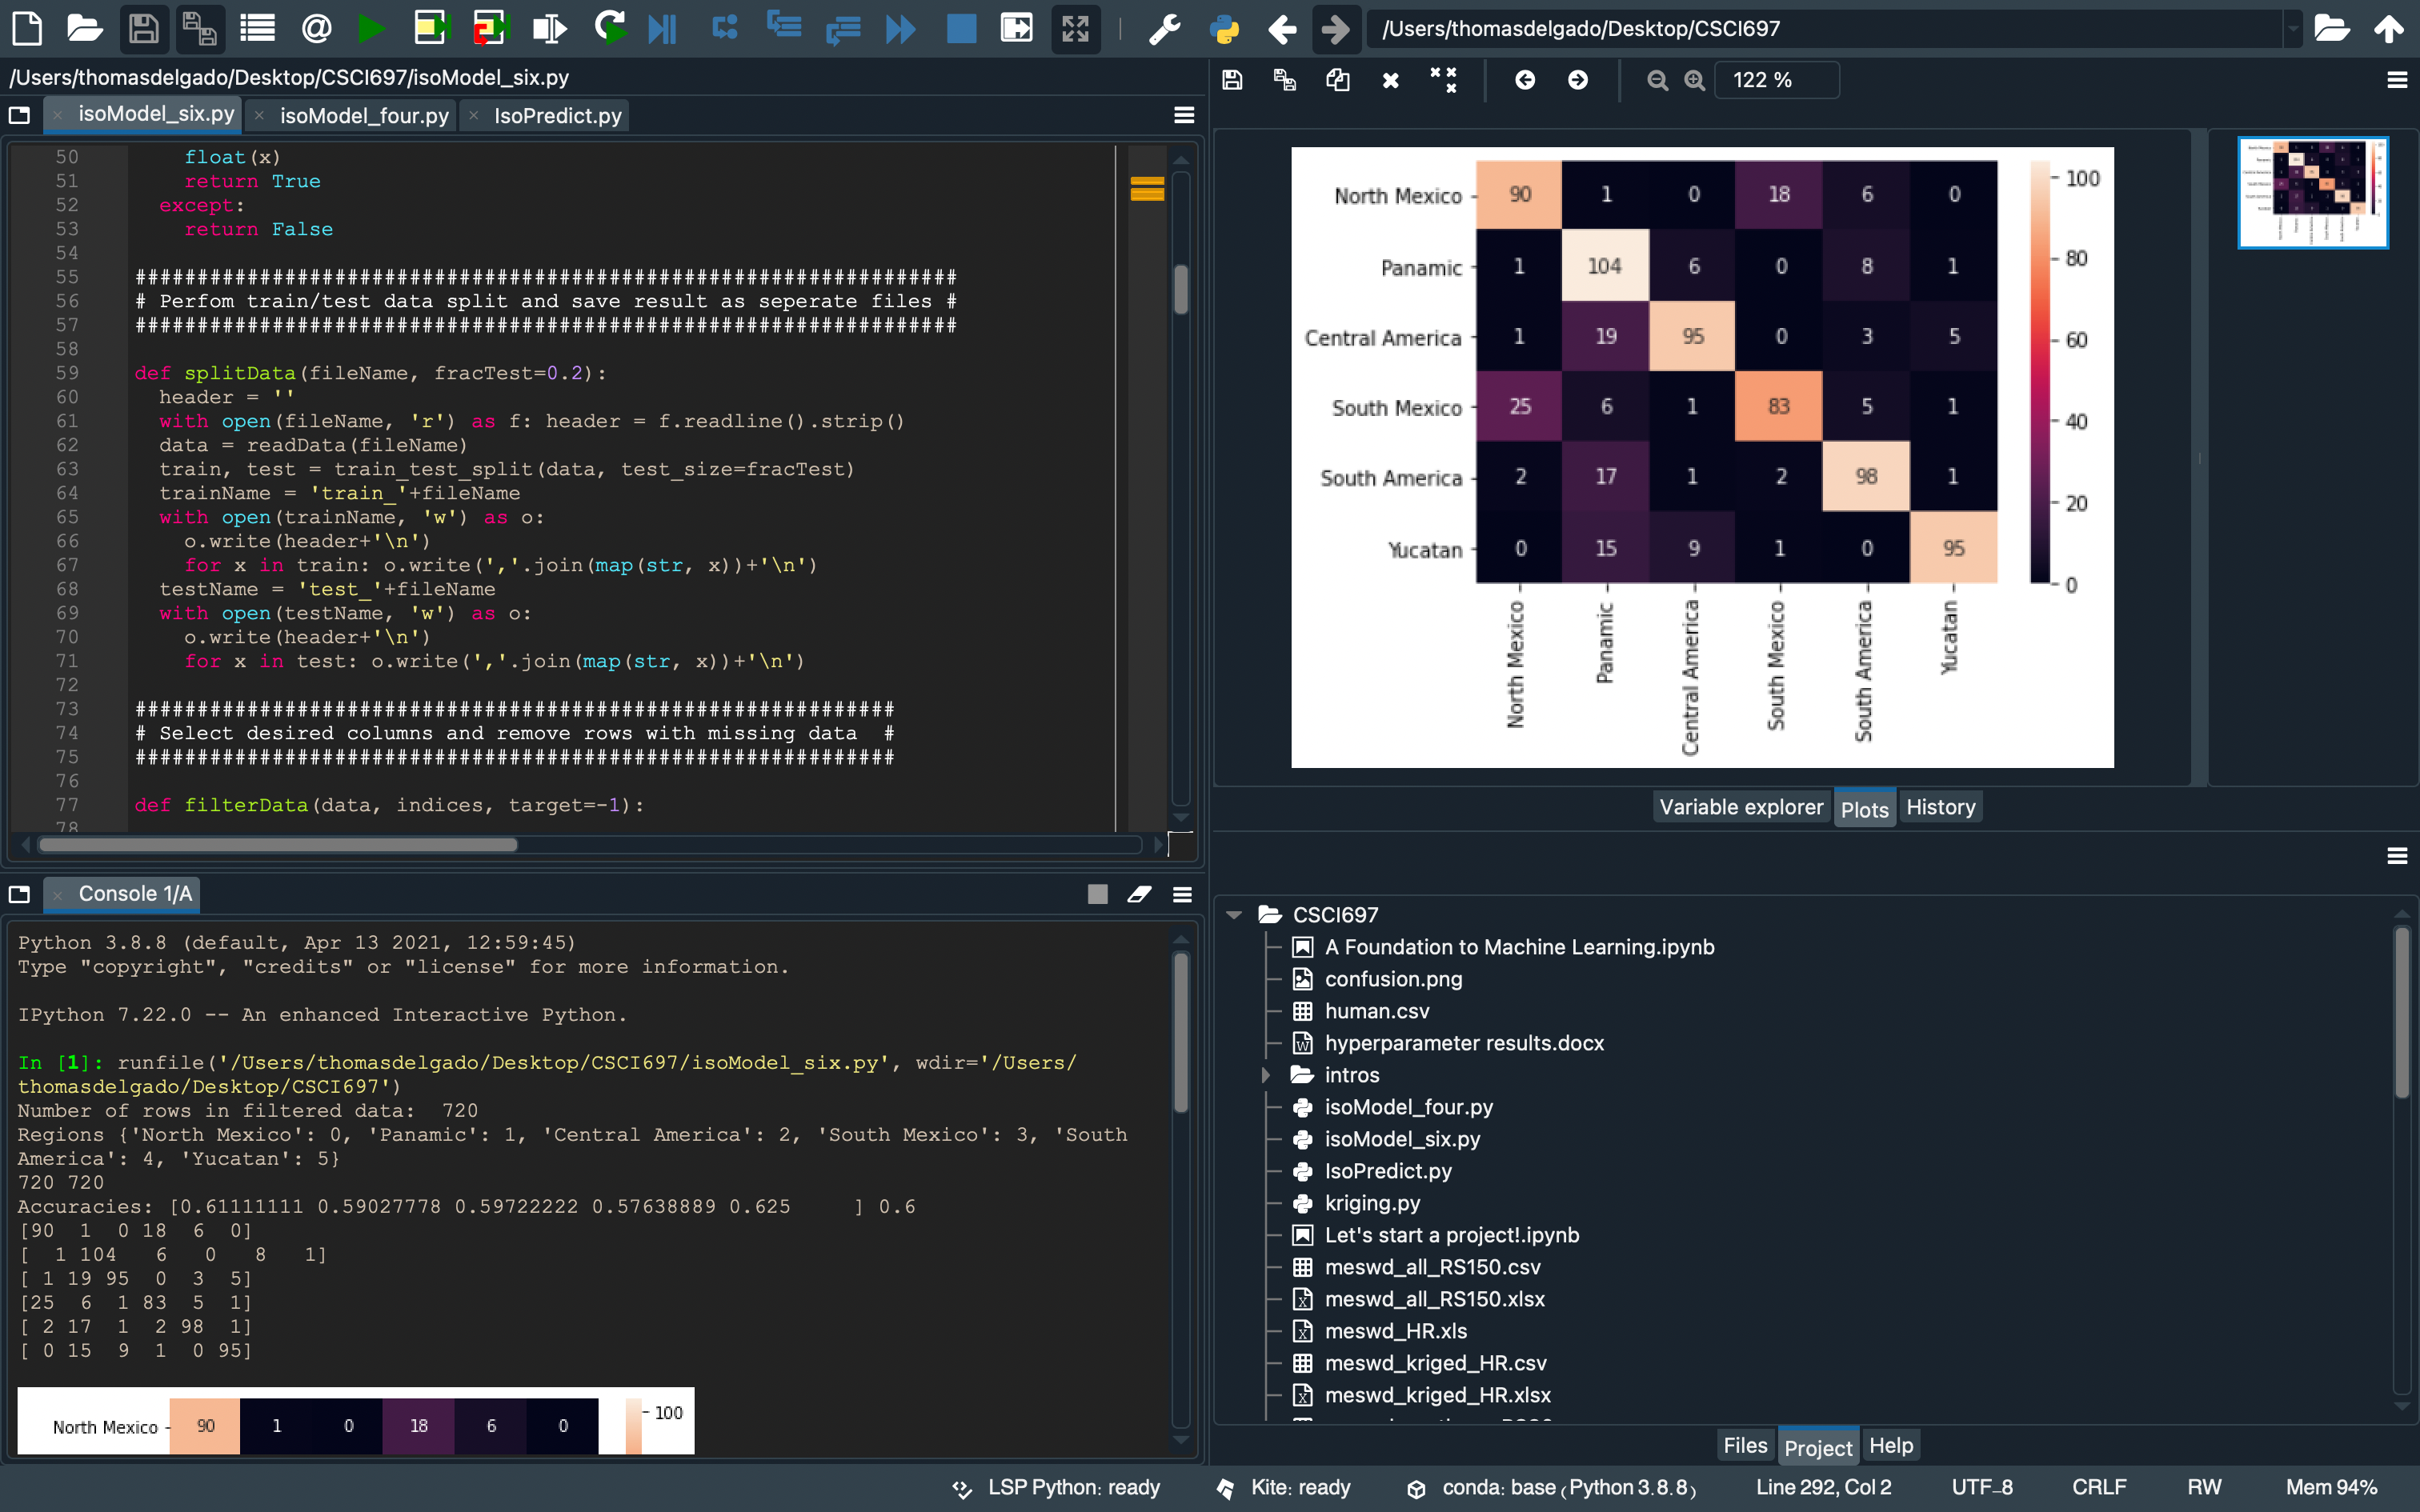

Coding
Research Design
Programming Language: Python v3.8.8
Libraries Used: Scikit-learn v1.2.0*, Seaborn, Pandas, Numpy
Coding Environment: Spyder v4.2.5
Notes:
The program itself was coded in the Python programming language primarily using libraries available from scikit-learn. These were chosen due to Python’s familiarity in machine learning spaces and the open-access nature of both resources. Coding was performed in the Spyder coding environment which offers a similar functionality to RStudio.

Slide 13
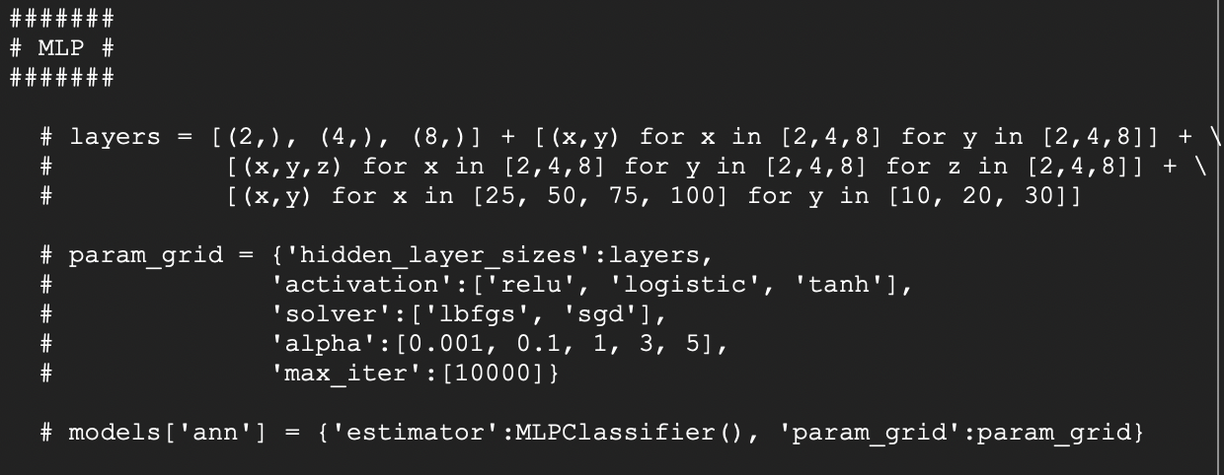
Algorithmization and Tuning
Research Design
Algorithms Used: Support Vector Machines (SVM), Random Forest Classifier (RFC), and Multilayer Perceptron (ANN)
Tuning Process: GridSearchCV and param.grid
Notes:
While six total algorithms are present in the program, we’re only going to focus on the support vector machine, the random forest classifier, and the artificial neural network. Each algorithm was tuned using the GridSearchCV function from scikit-learn which allows multiple parameters values to be defined in a parameter grid – seen here – before applying each potential parameter to the dataset and specifying which combination provided the best results. Unsurprisingly, this is a lengthy process.

Slide 14
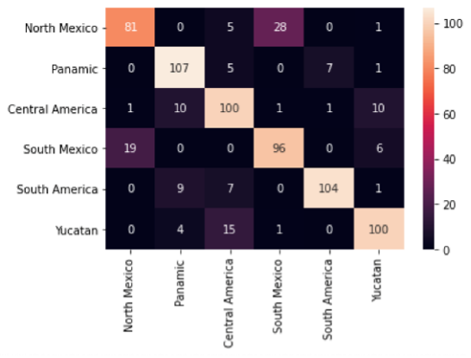
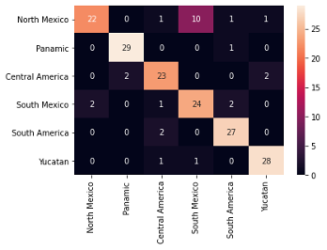
Artificial Neural Network
Results
Accuracy: 77% (training); 85% (testing)
F1 Score: 82% (training); 85%(testing)
Trends: Misclassify north Mexico as south Mexico and vice versa
Training
Testing
Actual
Predicted
Notes:
Now let’s turn to some results. These heatmaps show the specific classifications the model made with the actual region on the y-axis and the predicted region on the x-axis. A strong model will display its highest values on the diagonal line as seen here. Overall, the ANN demonstrated a 77 percent accuracy while training and an 85 percent accuracy while testing. F1 scores for training and testing both exceeded 80 percent demonstrating that this model is appropriate for this use. In general, the ANN tended to misclassify values from North Mexico as South Mexico and vice versa.

Slide 15
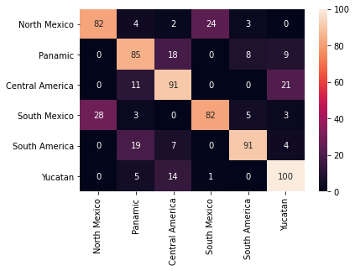
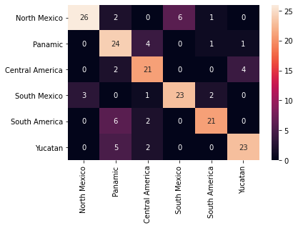
Support Vector Machine
Results
Accuracy: 72% (training); 77% (testing)
F1 Score: 74% (training); 77% (testing)
Trends: More consistent predictions during testing; misclassifies into adjacent region(s)
Training
Testing
Actual
Predicted
Notes:
The support vector machine achieved a 72 percent accuracy while training and 77 percent while testing. The F1 scores were also slightly lower averaging 75 percent. This model was more consistent in its predictions during testing as opposed to training with a majority of its misclassifications falling adjacent to the correct region.

Slide 16
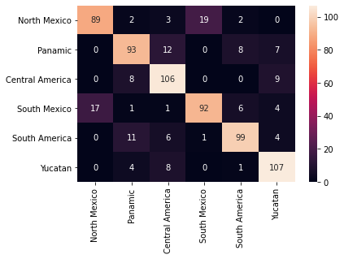
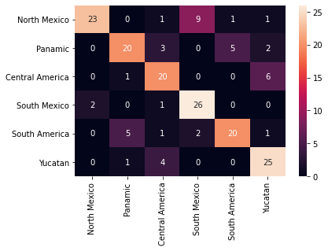
Random Forest Model
Results
Accuracy: 64% (training); 74% (testing)
F1 Score: 81% (training); 74% (testing)
Trends: More consistent predictions during training despite lower overall accuracy; misclassifies into adjacent region(s)
Training
Testing
Actual
Predicted
Notes:
The random forest model achieved a 64 percent accuracy while training and 74 percent while testing. The F1 scores here show a large spread with 81 percent achieved while training and 74 percent while training. In contrast to the support vector machine, this model had more consistent predictions during training in spite of its lower overall accuracy; however, it also tended to misclassify values into their adjacent regions.

Slide 17
Comparison of Performance
Results
Highest Performer: Artificial Neural Network
Considerations: SVMs work better with smaller datasets (more consistent predictions when testing); RFMs work better with larger datasets (more consistent predictions when training, higher f1)
Notes:
In comparing all three, we can see the ANN outperformed the other algorithms in both accuracy and f1 score. When considering the performance of the support vector and random forest models, it’s important to note that SVMs work better on smaller, less noisy datasets while Random Forests work best on larger datasets such as this. This is supported by the higher f1 score the random forest achieved suggesting its applicability to this purpose over the SVM but not the ANN.

Slide 18



Discussion and Conclusions
AI can enhance classification performance
Isotopic patterning can be detected by AI/ML
AI/DL could increase region-of-origin resolution
Incorporation of more isotopes
Integration of more complex deep learning methods (Convolutional NNs, Recurrent NNs, etc.)
Isoscape generation based on human tissues of known provenience
Expansion to other diasporic regions
Implications
/ Applications
AI models are not transparent (“black box”)
Isotopic data is U.S. and Europe-centric (extrapolation error)
Isotopic data is not primarily collected from human tissue
Future
Directions
Limitations
Notes:
So, what can we take from this research? AI can detect isotopic patterning and successfully classifies isotopic data. The incorporation of robust deep learning methodologies may serve to increase the resolution of isotopic classifications. This is not without some limitation in the interpretability of these models known as the black box effect, but further development will eventually increase interpretability. The provenancing of human tissues based on isotopic landscapes is also made challenging due to the lack of data outside the US and Europe, specifically from human tissues. As training AI models requires a large amount of data, the extrapolation of these values from a limited dataset will increase the inherent error in the data. Going forward, more isotopic data from different regions and tissues will need to be collected. The incorporation of more isotopes could also serve to increase the resolution of isotopic classification which would also necessitate more complex deep learning methods. Most importantly, this project can be modified for diasporic regions around the globe with the continued goal to return those who have suffered violence and oppression to their home.

Slide 19
References
Ben-Hur, Asa, and Jason Weston. 2010. “A User’s Guide to Support Vector Machines.” Methods in Molecular Biology (Clifton, N.J.) 609 (January): 223–39. https://doi.org/10.1007/978-1-60327-241-4_13.
Biau, Gérard, and Erwan Scornet. 2016. “A Random Forest Guided Tour.” Test 25 (2): 197–227. https://doi.org/10.1007/s11749-016-0481-7.
Chesson, Lesley A., Brett J. Tipple, James R. Ehleringer, Todd Park, and Eric J. Bartelink. 2018. “Forensic Applications of Isotope Landscapes (‘isoscapes’): A Tool for Predicting Region-of-Origin in Forensic Anthropology Cases.” Forensic Anthropology: Theoretical Framework and Scientific Basis, 127–48. https://doi.org/10.1002/9781119226529.ch8.
Jordan, M. I., and T. M. Mitchell. 2015. “Machine Learning: Trends, Perspectives, and Prospects.” Science 349 (6245): 255–60. https://doi.org/10.1126/science.aaa8415.
Kramer, Robyn T., Eric J. Bartelink, Nicholas P. Herrmann, Clement P. Bataille, and Kate Spradley. 2020. “Application of Stable Isotopes and Geostatistics to Infer Region of Geographical Origin for Deceased Undocumented Latin American Migrants.” In Forensic Science and Humanitarian Action, edited by Roberto C. Parra, Sara C. Zapico, and Douglas H. Ubelaker, 425–40. New York: Wiley. https://doi.org/10.1002/9781119482062.ch27.
Ma, C., Vander Zanden, H. B., Wunder, M. B., & Bowen, G. J. (2020). assignR: An r package for isotope-based geographic assignment. Methods in Ecology and Evolution, 11(8), 996–1001. https://doi.org/10.1111/2041-210X.13426
Pedregosa, F, G Varoquaux, A Gramfort, V Michel, B Thirion, O Grisel, M Blondel, et al. 2011. “Scikit-Learn: Machine Learning in {P}ython.” Journal of Machine Learning Research 12: 2825–30.
Notes:
Here are some references

Slide 20



Acknowledgements
This QR Code apparently got deactivated. Link is:
https://github.com/Tadelgado42/IsoPredict
Notes:
I couldn’t have completed this research without the support of funding received by Chico State and the Adelante Program at Chico State. The QR code to the GitHub is also up.

Slide 21
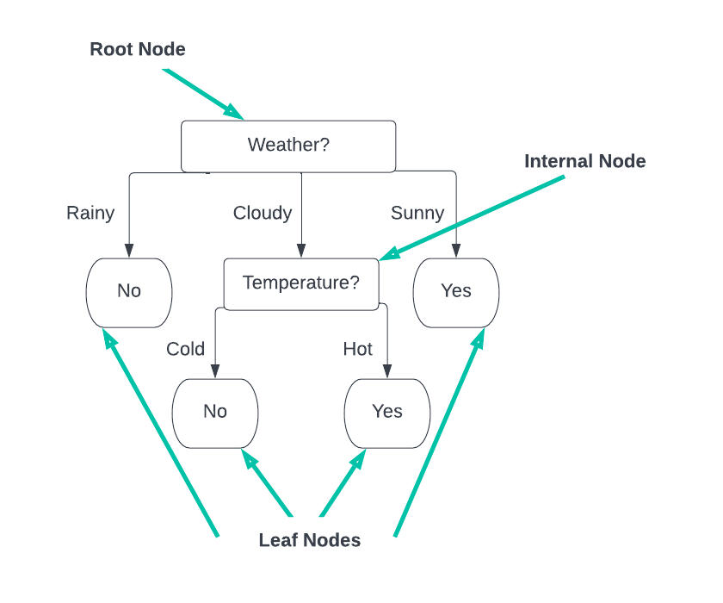
Random Forest: Decision Tree
Algorithmization
How does it work?
Misclassification rates (Gini) or feature similarity (Entropy)
Pros: Highly interpretable
Cons: Difficult to tune, difficult to generalize, risk overfitting
Notes:
This one may be more familiar, the decision tree! These have been used a fair amount in anthropology and work by using either rates of misclassification or feature similarity to pass data from node to node until a decision is reached. These have the benefit of being highly interpretable and easy to read; however, many parameters have to be considered when designing these models making them difficult to tune. They are also prone to overfitting the data as, by nature, the trees overfit the data before attempting to generalize it.

Slide 22
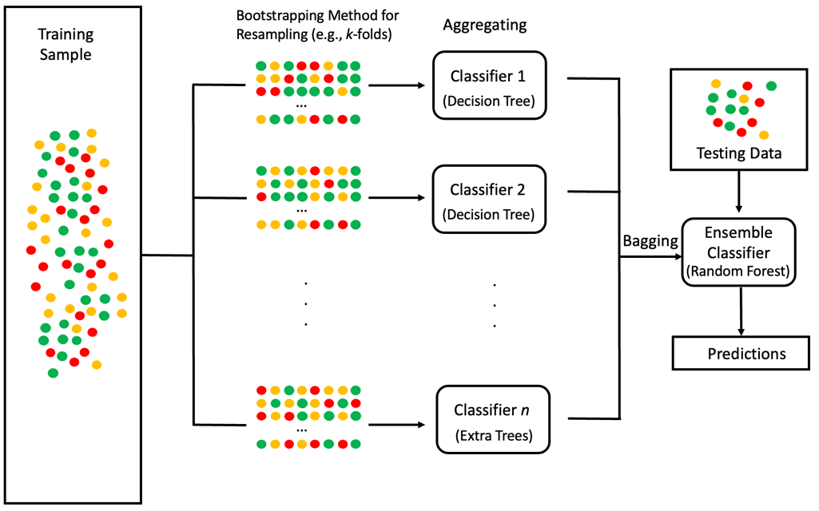
Random Forest: Ensemble Methods
Algorithmization
How does it work?
Bootstrap-Aggregating (Bagging)
Pros: Generally more accurate, less overfitting risk, more generalizable
Cons: High computing cost, degree of interpretability lost, overfitting still possible
Notes:
These shortcomings can be addressed through ensemble methods such as the random forest model – or RFC – that use a “bagging” method to create more accurate predictions with less risk of overfitting the data. Bagging works by resampling the training data into some number of smaller dataset and building classifiers for each of those datasets. The accuracies generated by those classifiers are then averaged and a prediction made. While this method remedies short-comings from using one tree, it does dramatically increase the computing cost to develop the model and a degree of interpretability is lost. And since it still uses decision-tree architecture the risk of overfitting is still present.

Slide 23
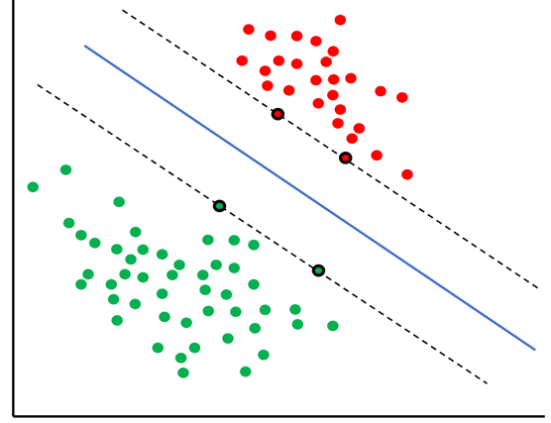
Support Vector Machines
Algorithmization
How does it work?
Separating hyperplane, maximum margin hyperplane, support vectors
Pros: Computationally efficient, multidimensional
Cons: Less effective on large and noisy datasets
Legend
Separating
Hyperplane
Maximum-Margin
Hyperplane
Support
Vectors
Notes:
Support vector machines – or SVMs – are more complex and rely on drawing two planes in multi-dimensional space to separate the data. The primary plane is the separating hyperplane – represented by the solid blue line – that, as the name suggests, separates the data into classes. The maximum-margin hyperplane – represented by the dashed lines – serves to maximize the difference between points. This plane is informed by the support vectors – the circled points – that determine this max distance. SVMs have the benefits of being computationally efficient and capable of interacting with and transforming multi-dimensional data. However, their effectiveness has been shown to decrease with very large and noisy datasets.

